Slide 1




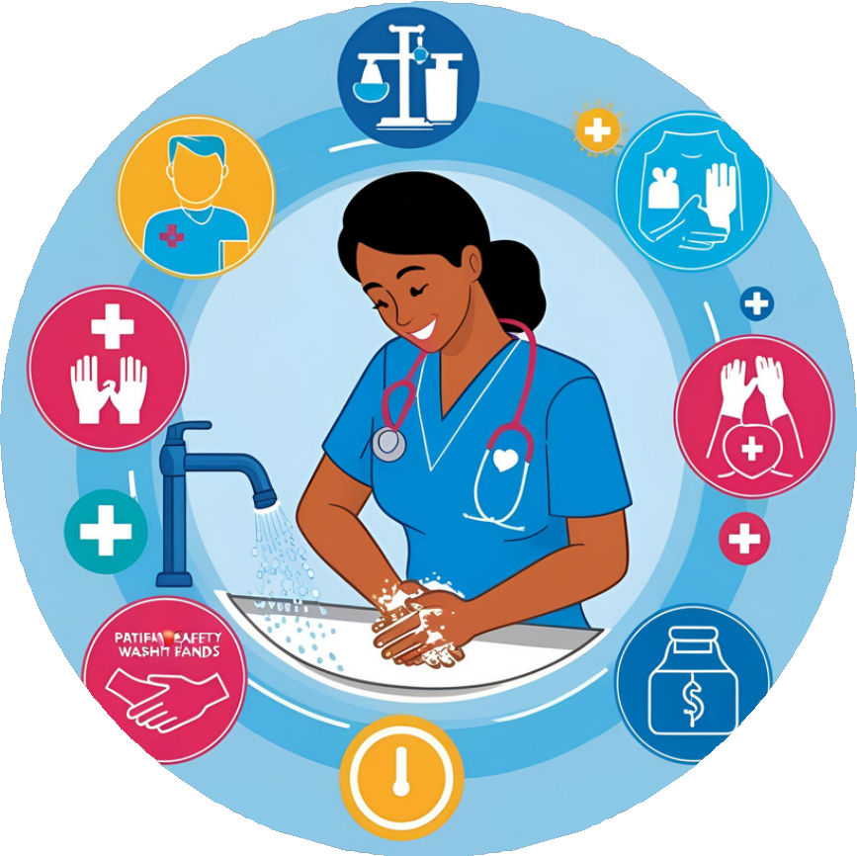

Health Care-Associated Infections (HAIs) and Infection Prevention & Control
A Focus on Ensuring Safe Health Care Environment
Dr. Mayuri Bhise, Assistant Professor, Dept of Microbiology, AIIMS Rajkot

Slide 2









Understanding Health Care-Associated Infections (HAIs)…..
Definition of HAIs: “An infection occurring in a patient during
the process of care in a hospital or other health-care facility which was not present or incubating at the time of admission. This includes infections acquired in the hospital, but appearing after discharge, and also occupational infections among staff of the facility”
Source: WHO Definition of HAI
https://www.who.int/news-room/feature-stories/detail/the-burden-of-health-care-associated-infection-worldwide

Slide 3


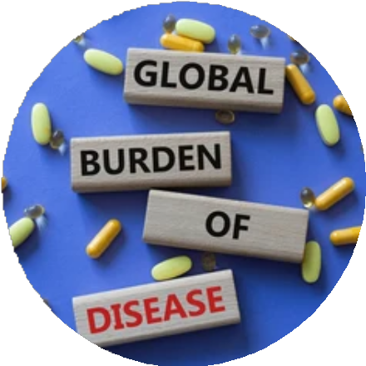
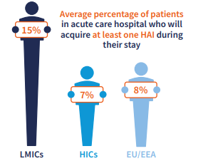
World-wide Impact of Health Care-Associated Infections (HAIs)
Global Burden:
Based on data from several countries, it can be estimated that each year, hundreds of millions of patients around the world are affected by HAI.
The burden of HAI is 7 patients in high-income countries and 15 in low- and middle-income countries per 100 patients admitted.
Globally, an estimated 1 in 10 patients in acute-care hospitals acquire at least one health care-associated infection (HAI) during their stay.
A survey conducted by the World Health Organization (WHO) across 55 hospitals in 14 countries revealed that nosocomial infections had a prevalence rate of 8.7% among hospitalized patients.
According to a report by the World Health Organization (WHO), approximately 10% of patients with healthcare-associated infections (HAIs) succumb to the infection.
Source:- WHO -The-burden-of-health-care-associated-infection-worldwide
Global infection prevention and control priorities 2018–22: a call for action , The lancet

Slide 4
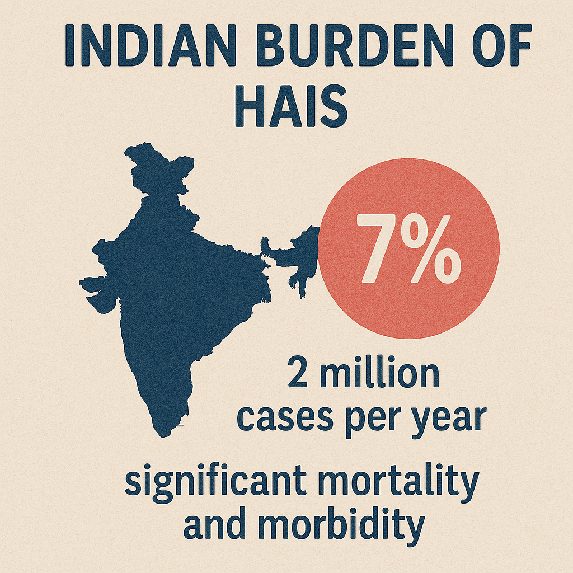
Indian Burden of Health Care-Associated Infections (HAIs)
Burden of HAI in India:
The burden of health-care-associated infections was also recently highlighted in Southeast Asian countries.
The Lancet Global Health report highlights significant variability in healthcare-associated infection (HAI) rates across India, with prevalence ranging from 11% to 83% depending on the type of infection. Among the most common HAIs reported in Indian hospitals are central line-associated bloodstream infections (CLABSI), catheter-associated urinary tract infections (CAUTI), surgical site infections (SSIs), and ventilator-associated pneumonia (VAP).
Source: Purva Mathur and etal. Health-care-associated bloodstream and urinary tract infections in a network of hospitals in India: a multicenter, hospital-based, prospective surveillance study. Lancet Glob Health. 2023;11(3):e123–e134. https://www.thelancet.com/journals/langlo/article/PIIS2214-109X(22)00317-5/fulltext

Slide 5


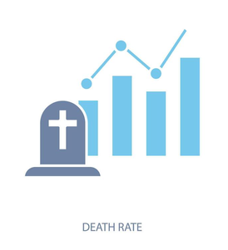








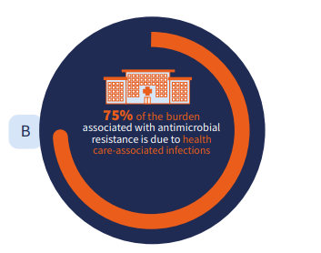
Impact of HAIs on Patient Safety
Clinical Consequences
Economic Consequences
Increased Morbidity and Mortality
Prolonged Hospitalization and Treatment
Psychological and Social Impact
Patient distress, lost trust, and lower quality of life.
Antimicrobial Resistance (AMR)
AMR makes infections harder to treat, increasing illness, costs, and death risk.

Slide 6













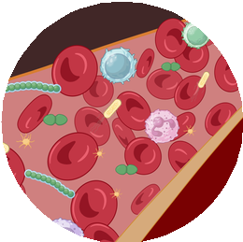

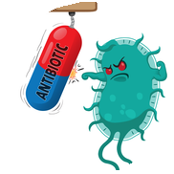
Catheter-associated urinary tract infections (CAUTI)
Common Types of HAIs in India
Central Line associated blood stream infections (CLABSI)
Ventilator associated pneumonia (VAP)
Surgical site infecions (SSI)
Clostridium difficile infections
Primary & Secondary Blood Stream Infections
Lower Respiratory Tract Infections
MDRO

Slide 7
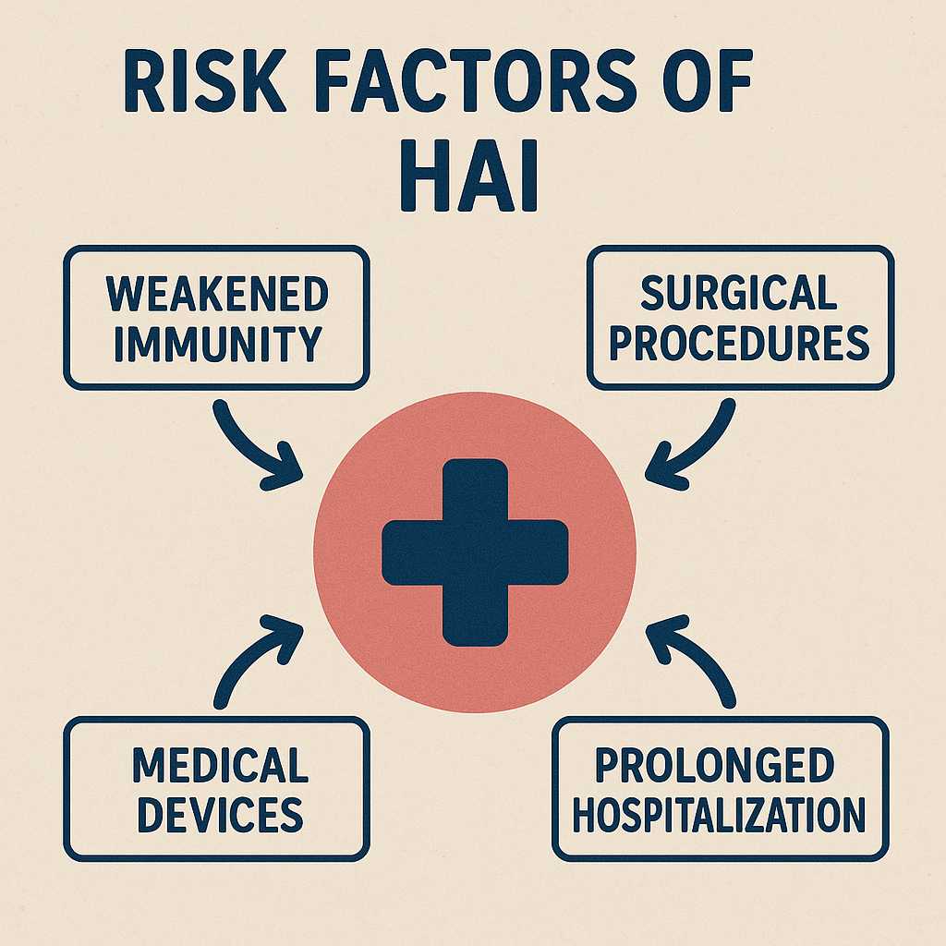
Associated Risks of HAIs
Patient-related factors:
Comorbidity and immunosuppression
Age
Health Care Related Factors:
Invasive Devices
Surgical Procedures
Environmental Factors:
Contaminated surfaces and equipment

Slide 8








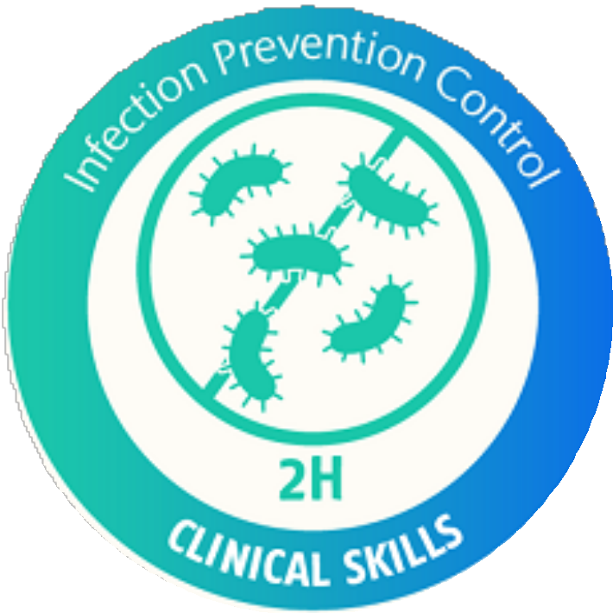










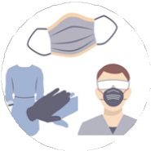
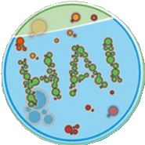






Infection Prevention & Control (IPC) Strategies to prevent HAIs
Hand Hygiene
Personal Protective Equipment (PPE)
Standard Precautions
Transmission-Based Precaution
Surveillance and Monitoring
Environmental Cleaning and Disinfection
Staff Education and Training
Antibiotic Stewardship

Slide 9







Infection Prevention & Control as Part of Patient Safety
Infection Prevention and Control (IPC) is a crucial aspect of patient
safety, aiming to prevent healthcare-associated infections (HAIs) and protect both patients and healthcare workers from harm.
Promoting disease-free environment
ICP in Special situations
Reduces HAIs
Principle of Asepsis
HAIs can be minimized by ensuring hand hygiene, sterilization, PPE use, safe procedures, antibiotic management, staff training, and regular IPC protocol checks.
Maintain hygiene, ensure clean water, promote vaccines, enforce IPC measures, and raise awareness about healthy practices.
Asepsis ensures sterility by preventing pathogens through hand hygiene, sterile tools, clean surfaces, and proper PPE use.
Focused IPC measures in ICUs, OTs, and dialysis units maintain sterility, lower infections, and boost patient safety.

Slide 10





Infection Prevention & Control as Part of Staff Safety
Infection Prevention and Control (IPC) is a crucial aspect of patient
safety, aiming to prevent healthcare-associated infections (HAIs) and protect both patients and healthcare workers from harm.
Environmental Hygeine & Sanitation
Staff Screening & Immunization
Preventing Occupational Hazards
Outbreak Policy
Disinfect surfaces, manage waste, control air quality, handle contaminants safely, and ensure clean water to lower infection risks and safeguard healthcare workers.
Health screenings detect disease carriers, and immunizations (e.g., flu, hepatitis B) protect staff, improving workplace safety and infection control.
Enforce PPE use, train staff, adopt ergonomic practices, conduct health screenings, ensure immunization, and manage waste effectively.
Quick detection, isolation, coordination with health authorities, IPC measures, and post-outbreak reviews prevent recurrence.

Slide 11
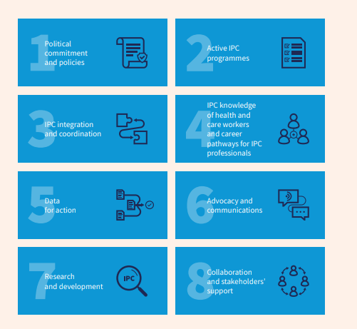

Role of IPC Team in promoting patient safety
Framing of SOPs
Ensure strict hand hygiene and proper use of PPE.
Adhere to sterilization protocols and safe procedures
Educate patients and monitor compliance with IPC measures.

Slide 12


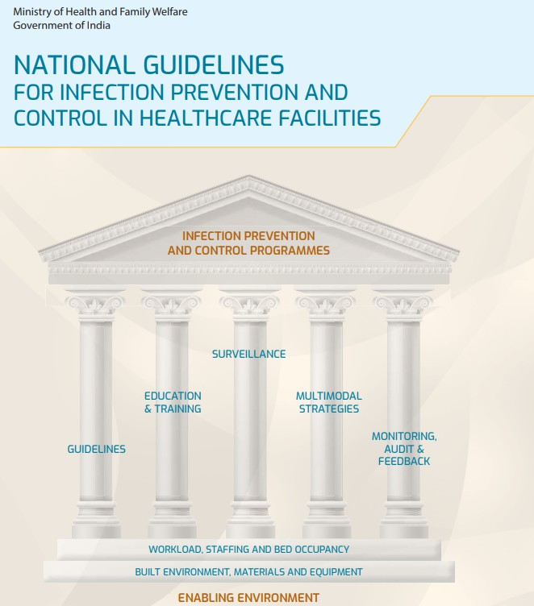




National Guidelines and Policies for IPC in India
Ministry of Health and Family Welfare (MoHFW)
1
2
National Centre for Disease Control (NCDC)
Guidelines For Implementation Of “Kayakalp” Initiative
3
4
National Action Plan on Antimicrobial Resistance (AMR)

Slide 13
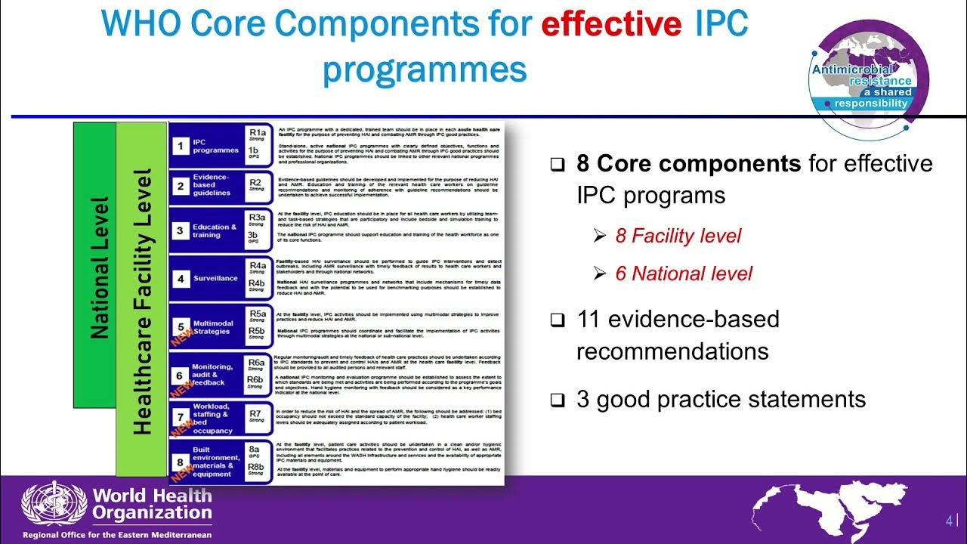
WHO’s Core Component Strategies to Prevent HAIs

Slide 14








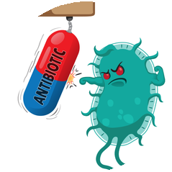


Challenges in Infection Prevention & Control in India
Infrastructural and resource constrictions
Lack of Trained Personnel
Behavioral and cultural barriers
Non-judicious/ irrational Antibiotic utilization
Lack of uniform policies and protocols

Slide 15









Implementing Effective IPC Strategies in India to overcome Challenges
Effective Training and Reinforcement
Adherence to Standard and transmission based Precautions
Robust HAI Surveillance & Care Bundle compliance
Rational and Judicious Antibiotic usage
Infrastructure & Resource Availability
Strong Leadership & Enforcement

Slide 16



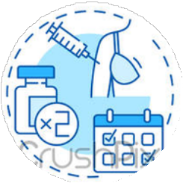




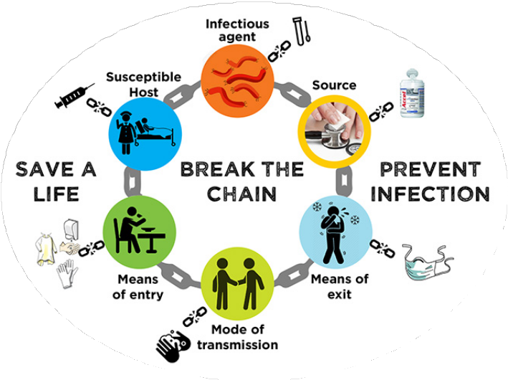
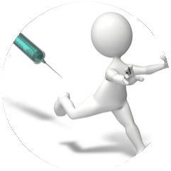

Summarizing Key Components of Infection Prevention & Control
Health Screenings
Immunization
AMSP
PPE & BMW
Staff Training
Hand Hygiene
Safe Injection Practices
Sterilization

Slide 17
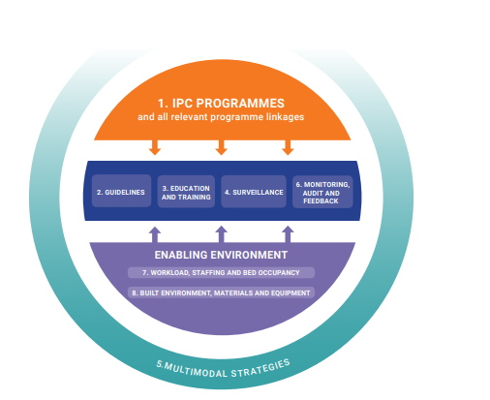
Take Home Message
Effective Infection Prevention and Control strategies are crucial in preventing Health care associated infections and thereby help in promoting patient safety
“Call to Action: Lets work together to implement evidence based IPC practices and reduce HAIs.”

Slide 18
References:
1) WHO. Report on the burden of endemic health care-associated infection worldwide. Geneva: World Health Organization, 2011.
2) Global infection prevention and control priorities 2018–22: a call for action, The Lancet
3)Health-care-associated bloodstream and urinary tract infections in a network of hospitals in India: a multicenter, hospital-based, prospective surveillance study. Lancet Glob Health. 2023;11(3):e123–e134. https://www.thelancet.com/journals/langlo/article/PIIS2214-109X(22)00317-5/fulltext
4) Ministry of Health and Family Welfare. Guidelines for the implementation of the “Kayakalp” initiative. New Delhi: Ministry of Health And Family Welfare, Government of India, 2018.
5) WHO. Minimum requirements for infection prevention and control programmes. Geneva: World Health Organization, 2019.

Slide 19


